Slide 1
28/02/2022
Title: Prime Powers
Aims:
Expand and simplify using indices.
Convert a number to a product of prime factors.
Plan:
Daily review: Indices and products of prime factors.
Factorizing to prime numbers

Slide 2
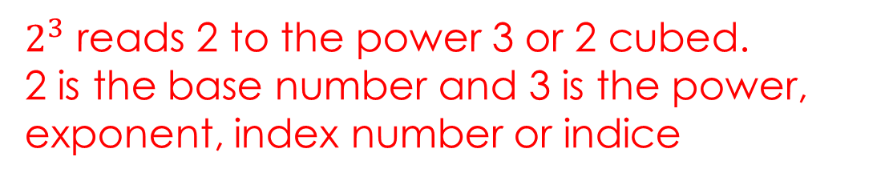
Daily review
Indices
Index number
Power
Exponent
Index numbers are represented using superscript notation.
An index number cannot exist without a base number.
Powers indicate repeated multiplication of the same base number.
$2^{3}$ reads 2 to the power 3 or 2 cubed.
2 is the base number and 3 is the power, exponent, index number or indice
Notes:
Student worksheet 1

Slide 3
Daily review
Indices
Index number
Power
Exponent
Index numbers are represented using superscript notation.
An index number cannot exist without a base number.
Powers indicate repeated multiplication of the same base number.
4 different expressions with the same meaning
$2^{3}$ reads 2 to the power 3 or 2 cubed.
2 is the base number and 3 is the power, exponent, index number or indice
Notes:
Student worksheet 1

Slide 4
When multiplying terms with the same base, you ____ the indices.
2⁶ x 2⁴
=
When dividing terms with the same base, you ________ the indices.
2⁵ ÷ 2²
=
When raising a power to another power, you multiply the powers.
(3⁵)³
=
=
Notes:
Work sheet 2

Slide 5
When multiplying terms with the same base, you add the indices.
2⁶ x 2⁴
= 2¹⁰
When dividing terms with the same base, you subtract the indices.
2⁵ ÷ 2²
= 2³
When raising a power to another power, you multiply the powers.
(3⁵)³
= 3⁵ x 3⁵ x 3⁵
= 3¹⁵

Slide 6
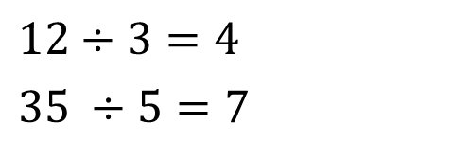
Factors: are numbers that divide evenly into another number.
3 is a factor of 12:
5 is a factor of 35:
List all the factors of 20
Prime numbers are numbers that have only 2 factors, 1 and itself.
Write 20 as a product of its factors
Write 20 as a product of its prime factors.
$12÷3=4$
$35 ÷5=7$
Notes:
Could use Choral reading and reversal on integer definition

Slide 7
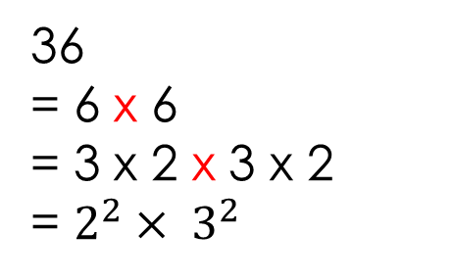
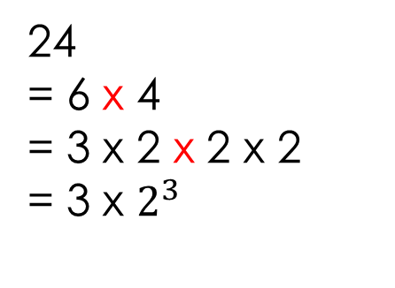
Whiteboards:
Write each of the following numbers as a product of prime factors.
24
= 6 x 4
= 3 x 2 x 2 x 2
= 3 x $2^{3}$
36
= 6 x 6
= 3 x 2 x 3 x 2
= $2^{2}× 3^{2}$

Slide 8
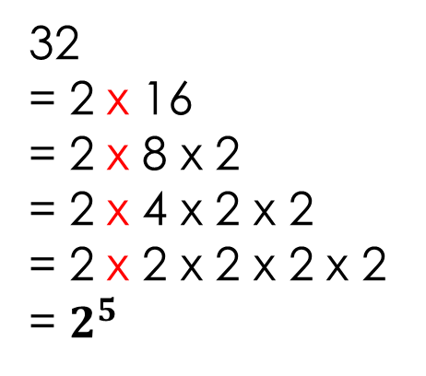
Whiteboards:
Write each of the following numbers as a product of prime factors.
42
= 2 x 21
= 2 x 7 x 3
32
= 2 x 16
= 2 x 8 x 2
= 2 x 4 x 2 x 2
= 2 x 2 x 2 x 2 x 2
= $2^{5}$

Slide 9
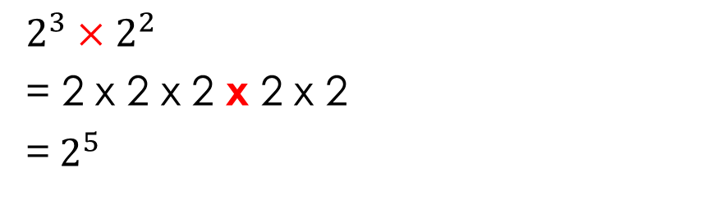
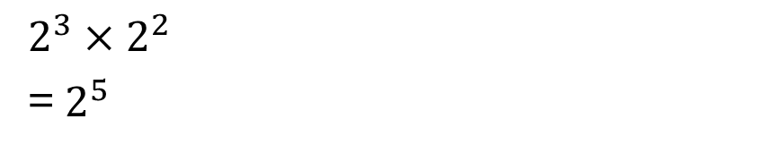

Simplifying expressions using indices.
$2^{3}×2^{2}$
= 2 x 2 x 2 x 2 x 2
=${ 2}^{5}$
$2^{3}×2^{2}$
=${ 2}^{5}$
Simplify
$2^{3}×2^{4}×2^{6}$
$2^{5}×3^{4}×2^{6}×3^{5}$
$2^{3}×4^{3}$
$\frac{2^{7}}{2^{4}}$
$\frac{3^{12}}{3^{7}}$
$\frac{5^{6}}{5^{12}}$

